Slide 1
Principles of Autonomy and Decision Making
(AI_PrincAutonomy_2808)
Team:
Prof. Dr. rer. nat. Lenz Belzner
Chidvilas Karpenahalli Ramakrishna, M.Eng.
Adithya Mohan, M.Eng.
Zahra Zeinaly, Ph.D.
Week 10: Neural Networks and Deep Q-Learning (DQN)

Slide 2
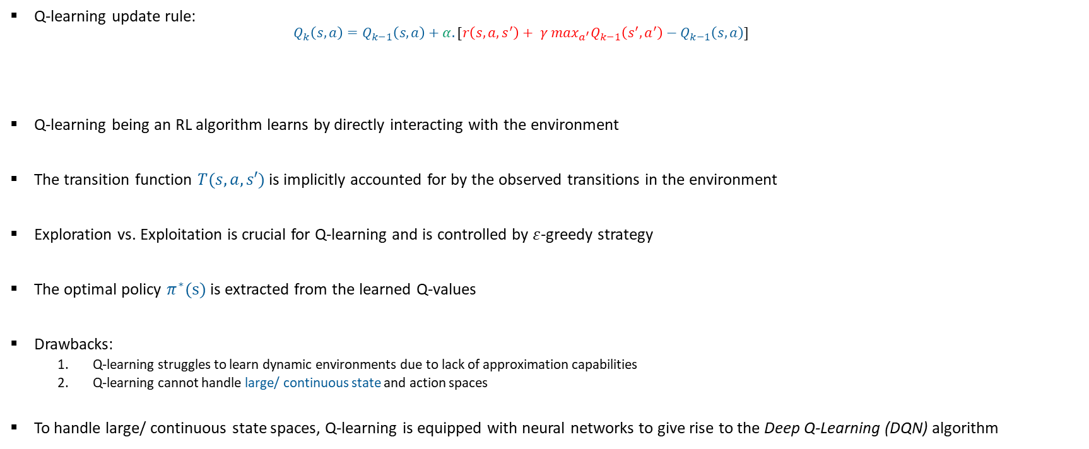
Recap: Q-learning
Week 10: Deep Q-Learning (DQN)
Target / estimation of optimal future value
Q-learning update rule:
$$Q_{k}\left(s,a\right)=Q_{k−1}\left(s,a\right)+α.[r\left(s,a,s^{′}\right)+ γ {\max_{a^{′}}Q}_{k−1}\left(s^{′},a^{′}\right)−Q_{k−1}\left(s,a\right)]$$
Q-learning being an RL algorithm learns by directly interacting with the environment
The transition function $T(s,a,s′)$ is implicitly accounted for by the observed transitions in the environment
Exploration vs. Exploitation is crucial for Q-learning and is controlled by $ε$-greedy strategy
The optimal policy $π^{∗}(s)$ is extracted from the learned Q-values
Drawbacks:
Q-learning struggles to learn dynamic environments due to lack of approximation capabilities
Q-learning cannot handle large/ continuous state and action spaces
To handle large/ continuous state spaces, Q-learning is equipped with neural networks to give rise to the Deep Q-Learning (DQN) algorithm
Updated Q-value
Old Q-value
Weight / learning rate
Current value

Slide 3
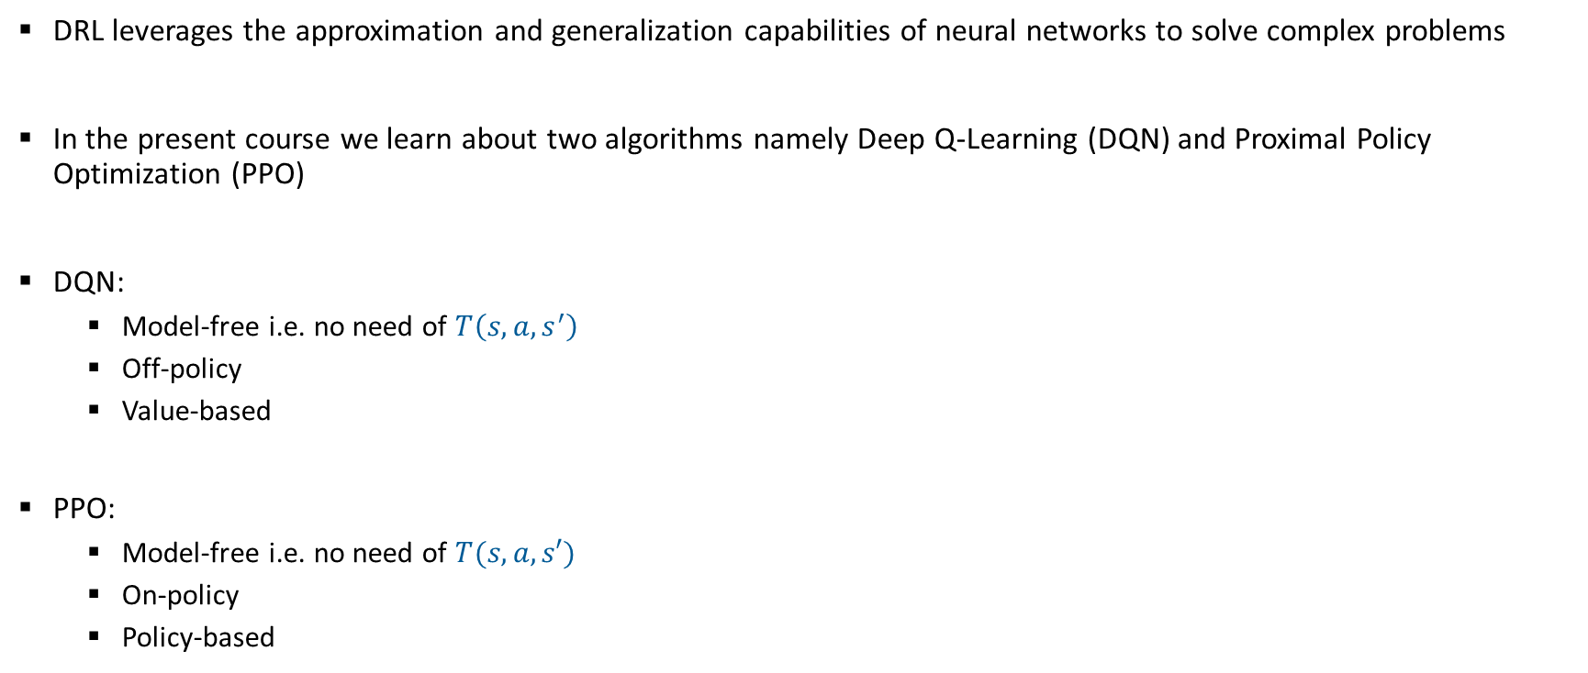
Deep Reinforcement Learning (DRL)
Week 10: Deep Q-Learning (DQN)
DRL leverages the approximation and generalization capabilities of neural networks to solve complex problems
In the present course we learn about two algorithms namely Deep Q-Learning (DQN) and Proximal Policy Optimization (PPO)
DQN:
Model-free i.e. no need of $T\left(s,a,s^{′}\right)$
Off-policy
Value-based
PPO:
Model-free i.e. no need of $T(s,a,s′)$
On-policy
Policy-based

Slide 4
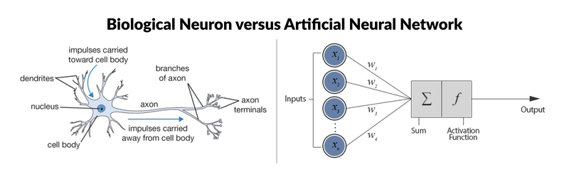
The Human Brain 🧠
Week 10: Deep Q-Learning (DQN)
Artificial Neural Networks (ANNs) or simply Neural Networks (NNs) are inspired by the human brain
Link between the human brain and NNs:
Neurons vs. Nodes
Synapses vs. weights
Activation vs. activation functions
Learning vs. training
Parallel processing
Fig. 1 Figure depicting the similarities between the human brain and ANNs

Slide 5
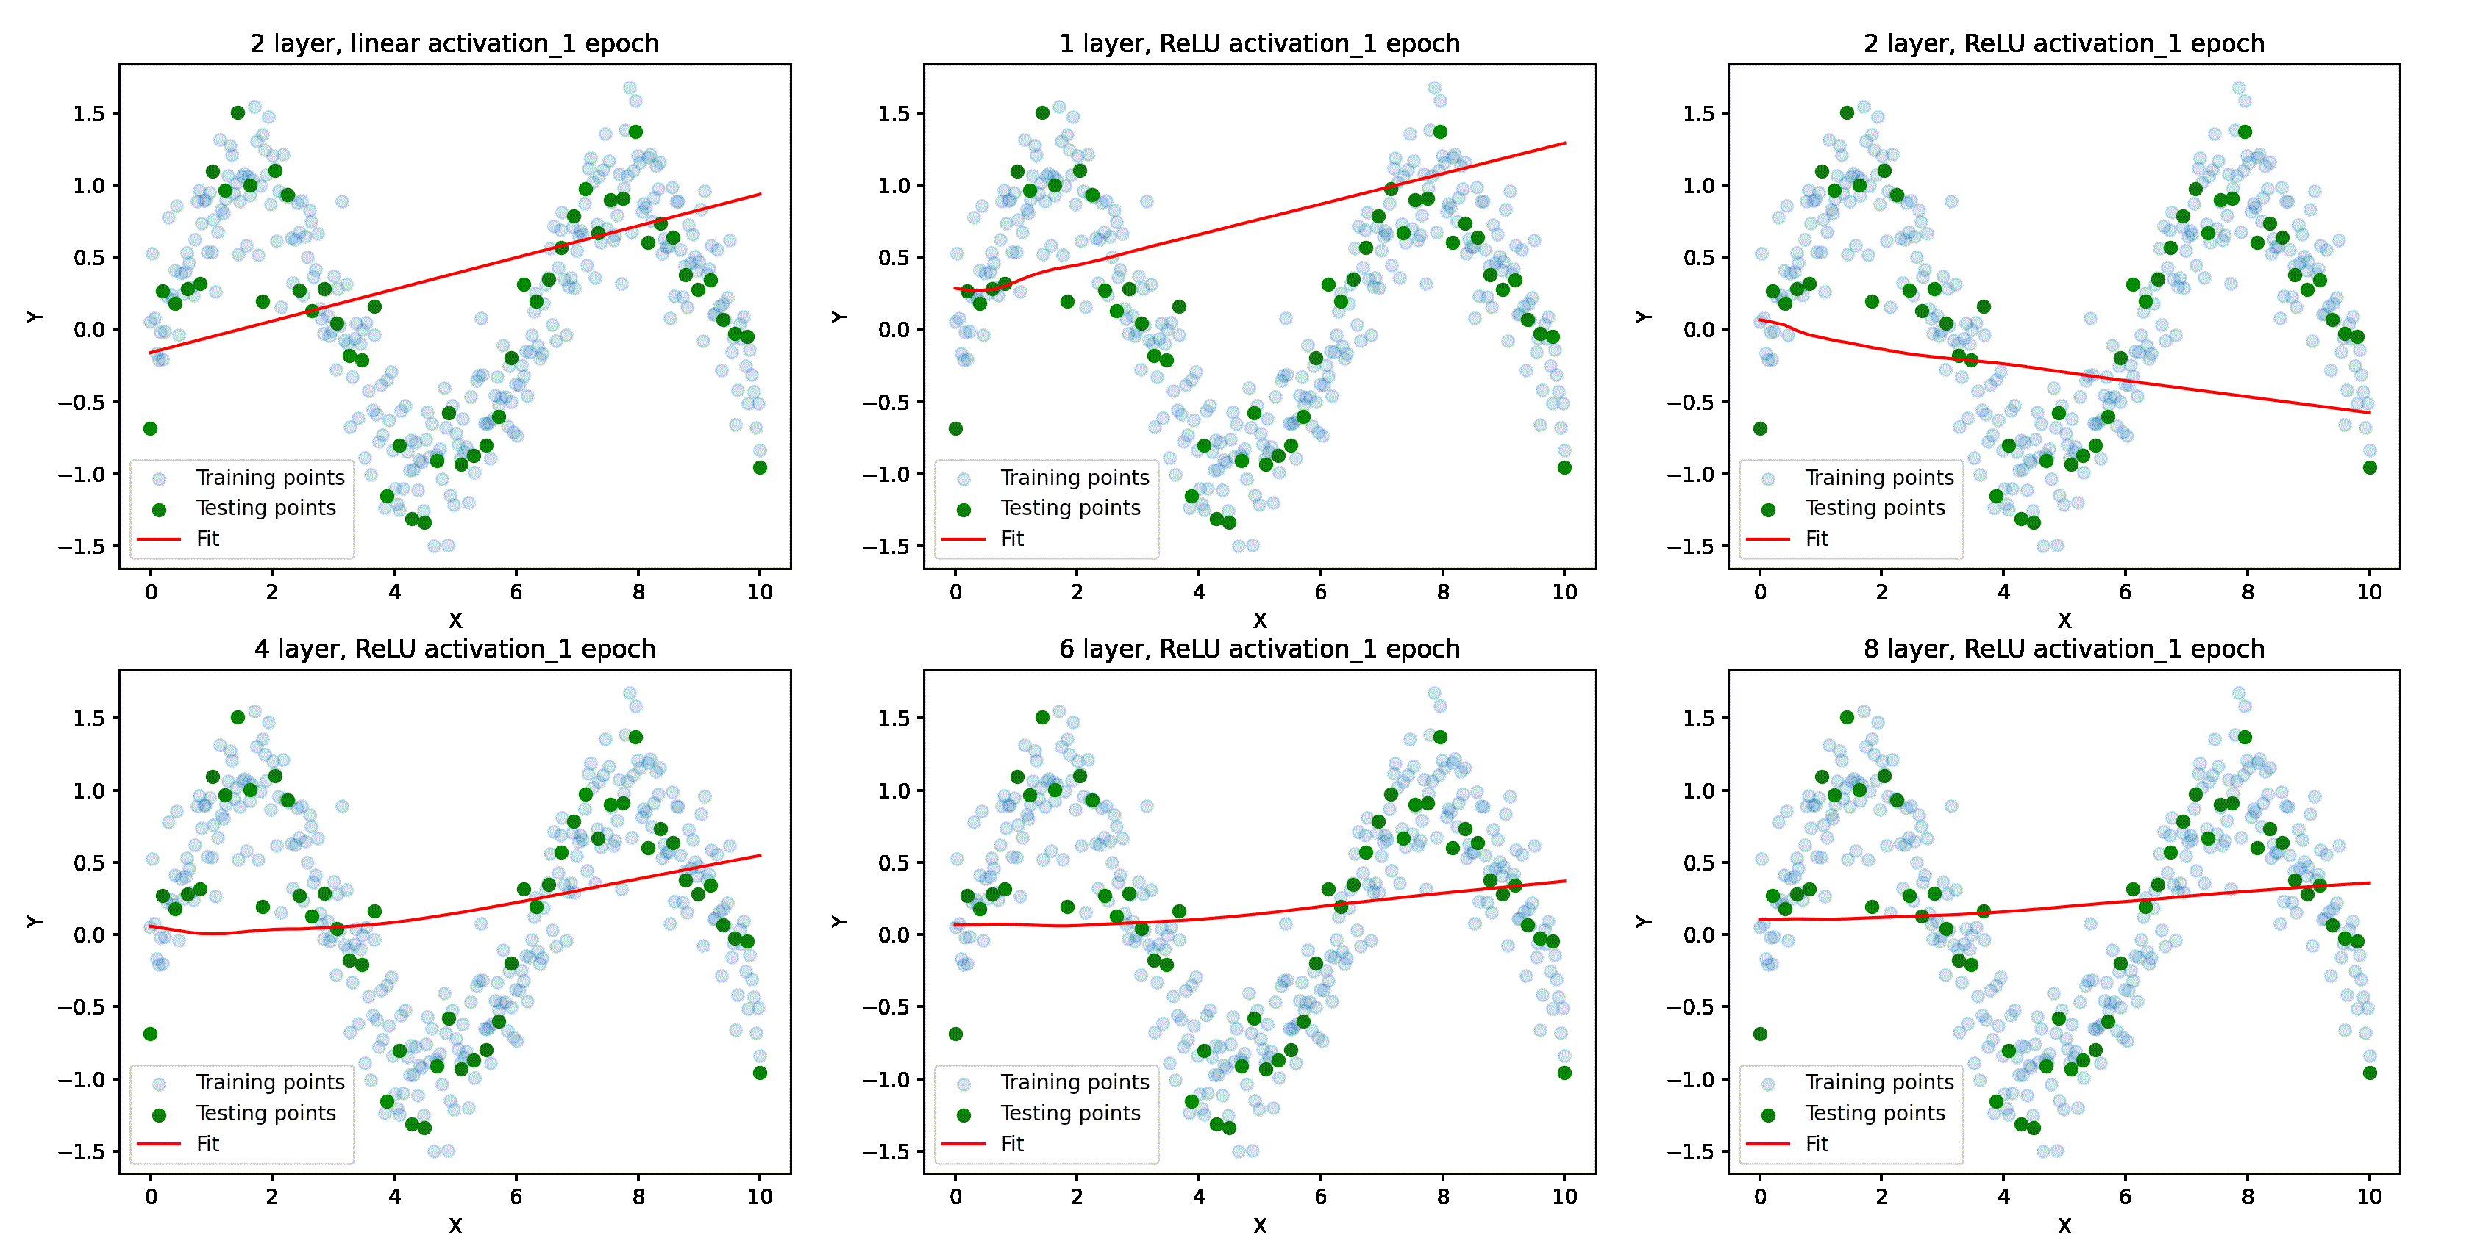
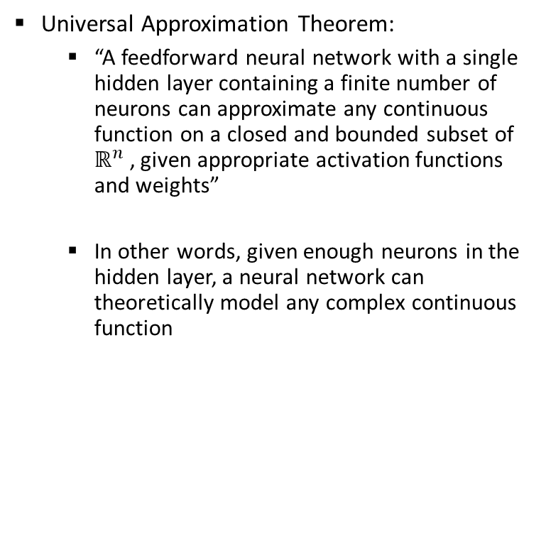
Neural Networks: Universal Approximation Theorem (UAT)
Week 10: Deep Q-Learning (DQN)
Universal Approximation Theorem:
“A feedforward neural network with a single hidden layer containing a finite number of neurons can approximate any continuous function on a closed and bounded subset of $ℝ^{n}$ , given appropriate activation functions and weights”
In other words, given enough neurons in the hidden layer, a neural network can theoretically model any complex continuous function
Fig. 1 Visualization of the approximation and generalization capabilities of neural networks
[Source: AVE, “Foundations of Machine Learning” course, SS23
Author: Chidvilas Karpenahalli Ramakrishna, M.Eng.]

Slide 6
Neural Networks: Basic structure
Week 10: Deep Q-Learning (DQN)
Neural Networks (NNs) are based on the UAT
NNs are capable of approximating complex, non-linear relationships
Basic concepts associated with NNs:
Dataset
Mini-batch
Neurons
Connections (weights and biases)
Activation functions
Layers
Input layer
Hidden layer
Output layer
Loss functions
Optimizers
Slide 7
Slide 8
Slide 9

Slide 7
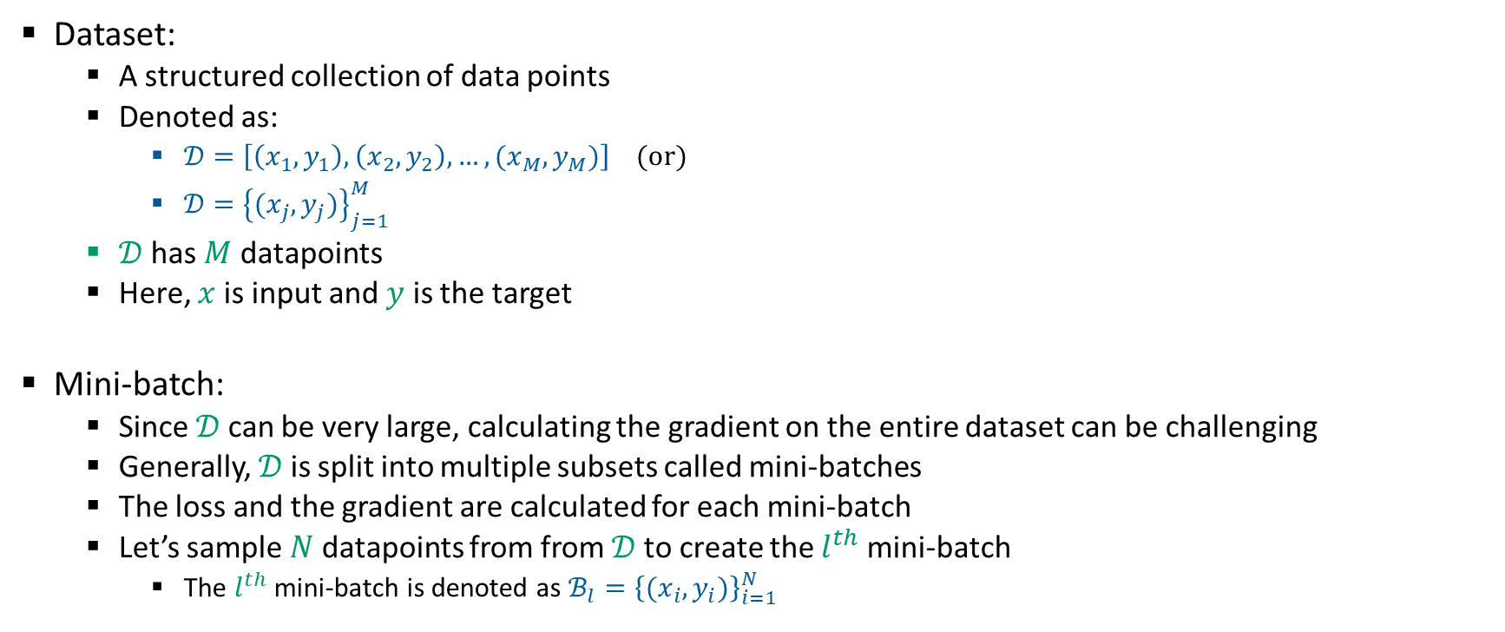
Neural Networks: Basic components
Week 10: Deep Q-Learning (DQN)
Dataset:
A structured collection of data points
Denoted as:
$𝒟=\left[\left(x_{1},y_{1}\right),\left(x_{2},y_{2}\right),…,(x_{M},y_{M})\right]$ (or)
$𝒟={\left\{(x_{j},y_{j})\right\}}_{j=1}^{M}$
$𝒟$ has $M$ datapoints
Here, $x$ is input and $y$ is the target
Mini-batch:
Since $𝒟$ can be very large, calculating the gradient on the entire dataset can be challenging
Generally, $𝒟$ is split into multiple subsets called mini-batches
The loss and the gradient are calculated for each mini-batch
Let’s sample $N$ datapoints from from $𝒟$ to create the $l^{th}$ mini-batch
The $l^{th}$ mini-batch is denoted as $ℬ_{l}={\left\{(x_{i},y_{i})\right\}}_{i=1}^{N}$

Slide 8
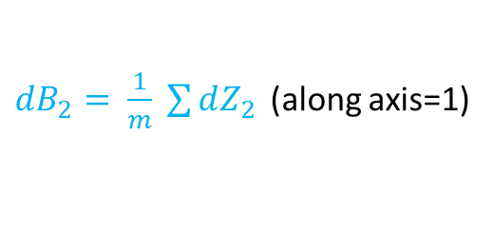
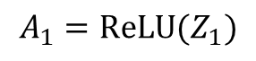
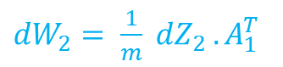
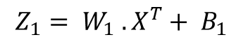
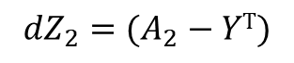
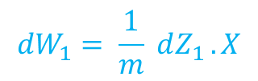
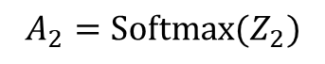
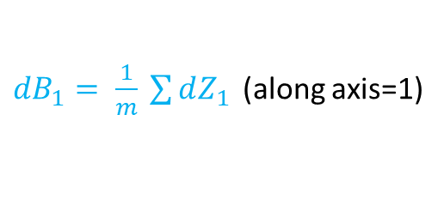
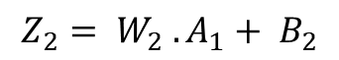
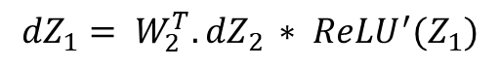
Neural Networks: Basic components
Week 10: Deep Q-Learning (DQN)
Hidden layer
Forward Propagation
Back Propagation
$$Z_{1}= W_{1} .X^{T}+ B_{1}$$
$${dZ}_{2}=(A_{2}−YT)$$
$$A_{1}=ReLU(Z_{1})$$
${dW}_{2}= \frac{1}{m} dZ_{2 }.A_{1}^{T}$
Input layer
$$Z_{2}= W_{2} .A_{1}+ B_{2}$$
${dB}_{2}= \frac{1}{m} \sum{dZ_{2 }}$ (along axis=1)
Output layer
$$A_{2}=Softmax(Z_{2})$$
$${dZ}_{1}= W_{2}^{T}. dZ_{2 }∗ {ReLU}^{′}(Z_{1})$$
Z₂, A₂
$${dW}_{1}= \frac{1}{m} dZ_{1 }. X$$
${dB}_{1}= \frac{1}{m} \sum{dZ_{1 }}$ (along axis=1)
W_{1,} B₁
W_{2,} B₂
Z₁, A₁
Fig. 1 Basic structure of a neural network
[Source: AVE, “Foundations of Machine Learning” course, SS23
Author: Chidvilas Karpenahalli Ramakrishna, M.Eng.]

Slide 9
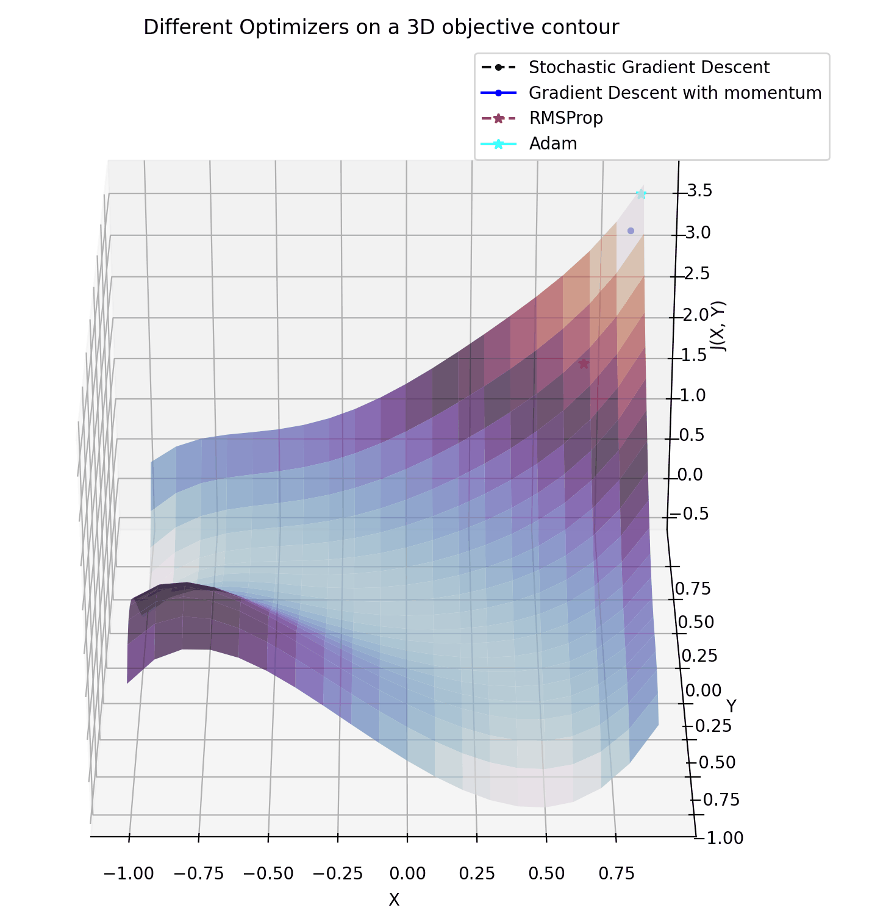
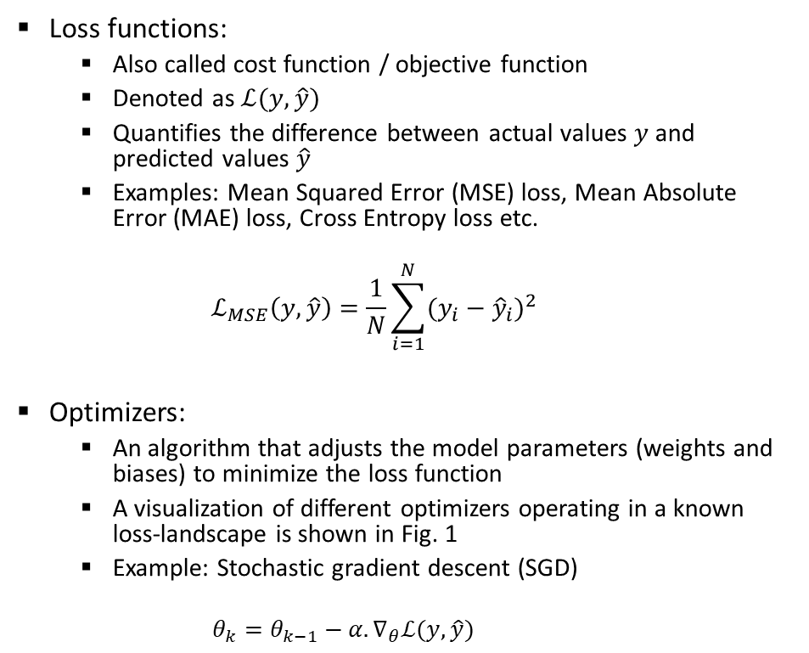
Neural Networks: Basic components
Week 10: Deep Q-Learning (DQN)
Loss functions:
Also called cost function / objective function
Denoted as $ℒ(y,\hat{y})$
Quantifies the difference between actual values $y$ and predicted values $\hat{y}$
Examples: Mean Squared Error (MSE) loss, Mean Absolute Error (MAE) loss, Cross Entropy loss etc.
$$ℒ_{MSE}\left(y,\hat{y}\right)=\frac{1}{N}\sum_{i=1}^{N}{{(y_{i}−{\hat{y}}_{i})}^{2}}$$
Optimizers:
An algorithm that adjusts the model parameters (weights and biases) to minimize the loss function
A visualization of different optimizers operating in a known loss-landscape is shown in Fig. 1
Example: Stochastic gradient descent (SGD)
$$θ_{k}=θ_{k−1}−α.∇_{θ}ℒ(y,\hat{y})$$
Fig. 1 Different optimizers in action
[Source: AVE, “Foundations of Machine Learning” course, SS23
Author: Chidvilas Karpenahalli Ramakrishna, M.Eng.]

Slide 10
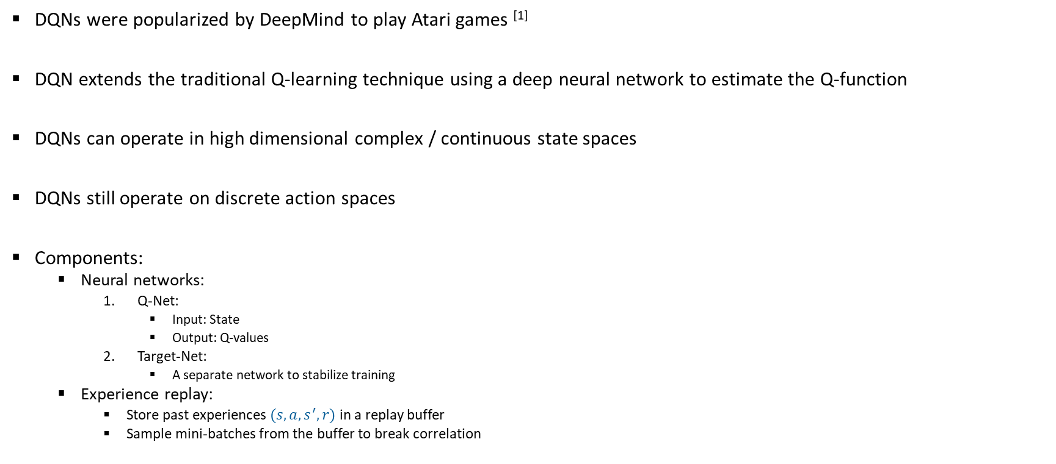
DQN: Introduction
Week 10: Deep Q-Learning (DQN)
DQNs were popularized by DeepMind to play Atari games ^{[1]}
DQN extends the traditional Q-learning technique using a deep neural network to estimate the Q-function
DQNs can operate in high dimensional complex / continuous state spaces
DQNs still operate on discrete action spaces
Components:
Neural networks:
Q-Net:
Input: State
Output: Q-values
Target-Net:
A separate network to stabilize training
Experience replay:
Store past experiences $(s,a,s^{′},r)$ in a replay buffer
Sample mini-batches from the buffer to break correlation
[1] Mnih, V., Kavukcuoglu, K., Silver, D., Rusu, A. A., Veness, J., Bellemare, M. G., ... & Hassabis, D. (2015). Human-level control through deep reinforcement learning. Nature, 518(7540), 529-533

Slide 11
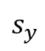
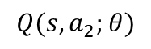
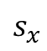
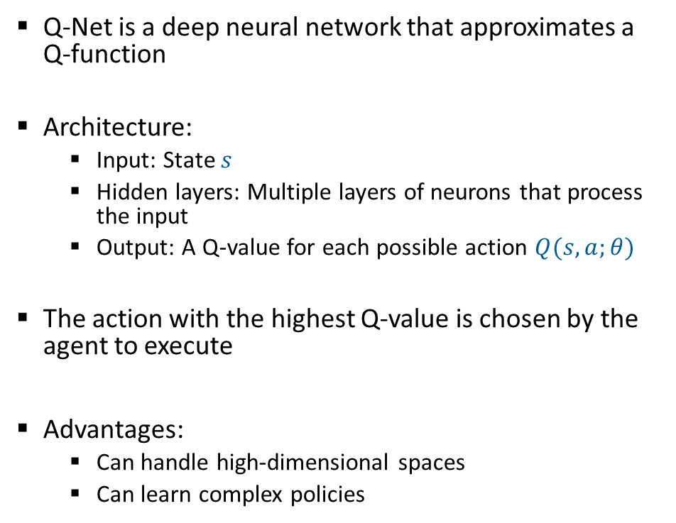
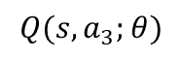
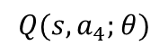
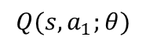
DQN: Q-Net
Week 10: Deep Q-Learning (DQN)
Hidden layer
Q-Net is a deep neural network that approximates a Q-function
Architecture:
Input: State $s$
Hidden layers: Multiple layers of neurons that process the input
Output: A Q-value for each possible action $Q(s,a;θ)$
The action with the highest Q-value is chosen by the agent to execute
Advantages:
Can handle high-dimensional spaces
Can learn complex policies
Output layer
Input layer
$$Q(s,a_{1};θ)$$
$$s_{x}$$
$$Q(s,a_{2};θ)$$
$$s_{y}$$
$$Q(s,a_{3};θ)$$
$$Q(s,a_{4};θ)$$
Fig. 1 A DQN with state (x,y) as input and 4 Q-values representing the 4 different actions {up, down, left, right} as output

Slide 12
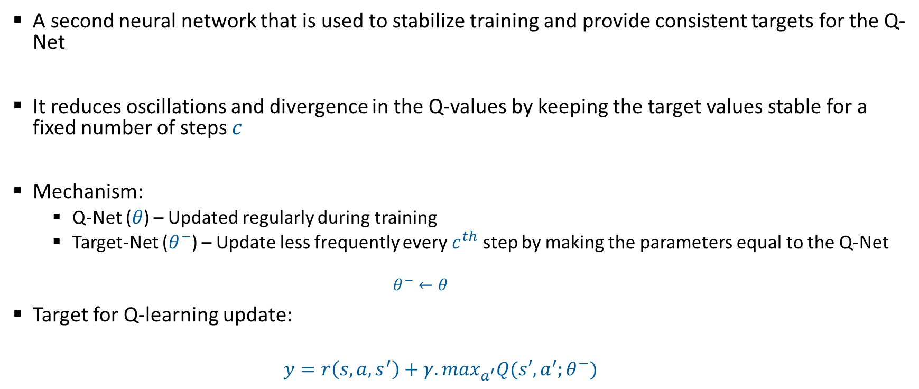
DQN: Target Network
Week 10: Deep Q-Learning (DQN)
A second neural network that is used to stabilize training and provide consistent targets for the Q-Net
It reduces oscillations and divergence in the Q-values by keeping the target values stable for a fixed number of steps $c$
Mechanism:
Q-Net ($θ$) – Updated regularly during training
Target-Net ($θ^{−}$) – Update less frequently every $c^{th}$ step by making the parameters equal to the Q-Net
$$θ^{−}←θ$$
Target for Q-learning update:
$$y=r\left(s,a,s^{′}\right)+γ.\max_{a^{′}}Q(s′,a^{′};θ^{−})$$

Slide 13
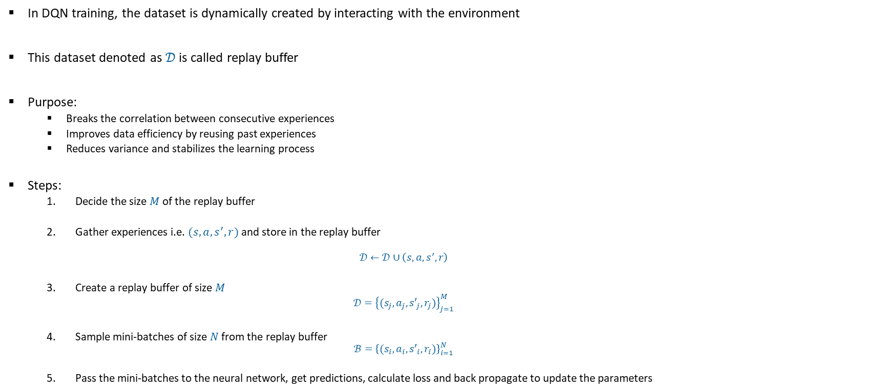
DQN: Experience Replay
Week 10: Deep Q-Learning (DQN)
In DQN training, the dataset is dynamically created by interacting with the environment
This dataset denoted as $𝒟$ is called replay buffer
Purpose:
Breaks the correlation between consecutive experiences
Improves data efficiency by reusing past experiences
Reduces variance and stabilizes the learning process
Steps:
Decide the size $M$ of the replay buffer
Gather experiences i.e. $(s,a,s^{′},r)$ and store in the replay buffer
$$𝒟←𝒟∪\left(s,a,s^{′},r\right)$$
Create a replay buffer of size $M$
$$𝒟={\left\{(s_{j},a_{j},{s′}_{j},r_{j})\right\}}_{j=1}^{M}$$
Sample mini-batches of size $N$ from the replay buffer
$$ℬ={\left\{(s_{i},a_{i},{s′}_{i},r_{i})\right\}}_{i=1}^{N}$$
Pass the mini-batches to the neural network, get predictions, calculate loss and back propagate to update the parameters

Slide 14
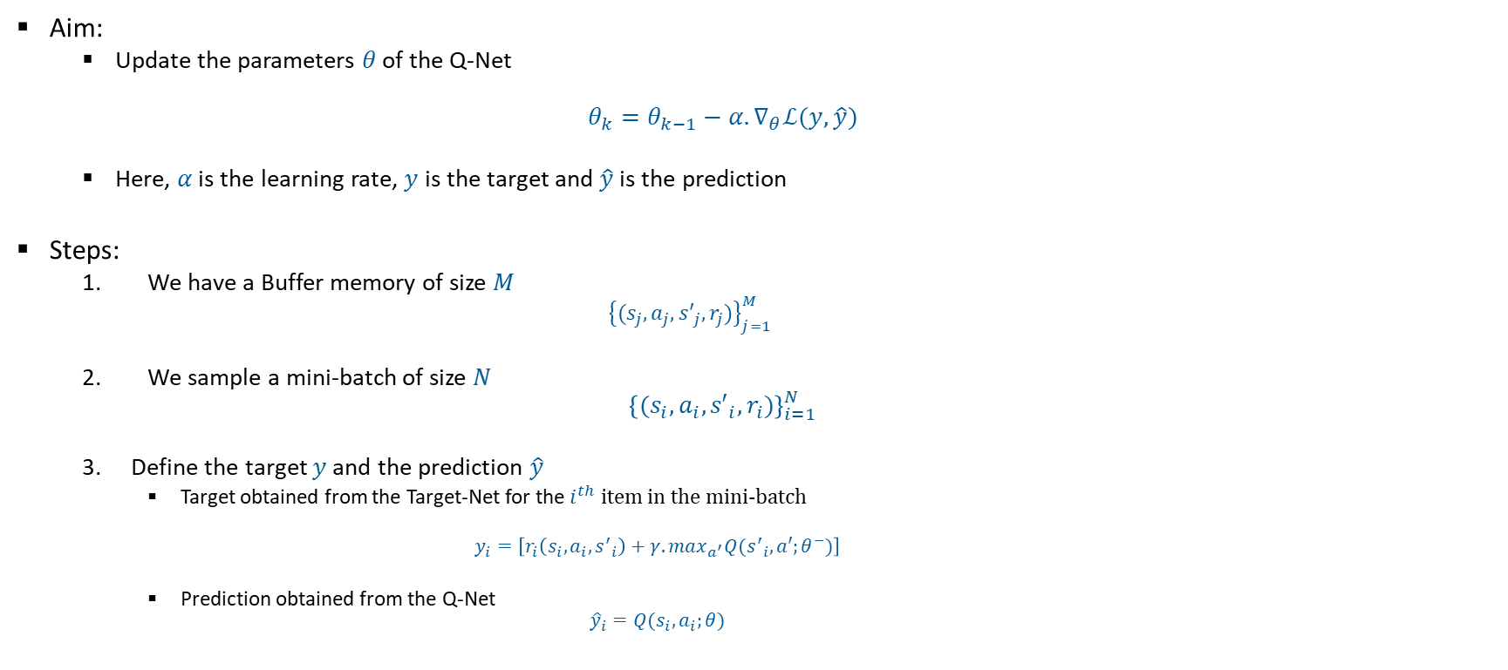
DQN: Update rule
Week 10: Deep Q-Learning (DQN)
Aim:
Update the parameters $θ$ of the Q-Net
$$θ_{k}=θ_{k−1}−α.∇_{θ}ℒ(y,\hat{y})$$
Here, $α$ is the learning rate, $y$ is the target and $\hat{y}$ is the prediction
Steps:
We have a Buffer memory of size $M$
$${\left\{(s_{j},a_{j},{s′}_{j},r_{j})\right\}}_{j=1}^{M}$$
We sample a mini-batch of size $N$
$${\left\{(s_{i},a_{i},{s′}_{i},r_{i})\right\}}_{i=1}^{N}$$
Define the target $y$and the prediction $\hat{y}$
Target obtained from the Target-Net for the $i^{th}$ item in the mini-batch
$$y_{i}=\left[r_{i}\left(s_{i},a_{i},{s^{′}}_{i}\right)+γ.\max_{a^{′}}Q({s^{′}}_{i},a′;θ^{−})\right]$$
Prediction obtained from the Q-Net
$${\hat{y}}_{i}=Q(s_{i},a_{i};θ)$$

Slide 15
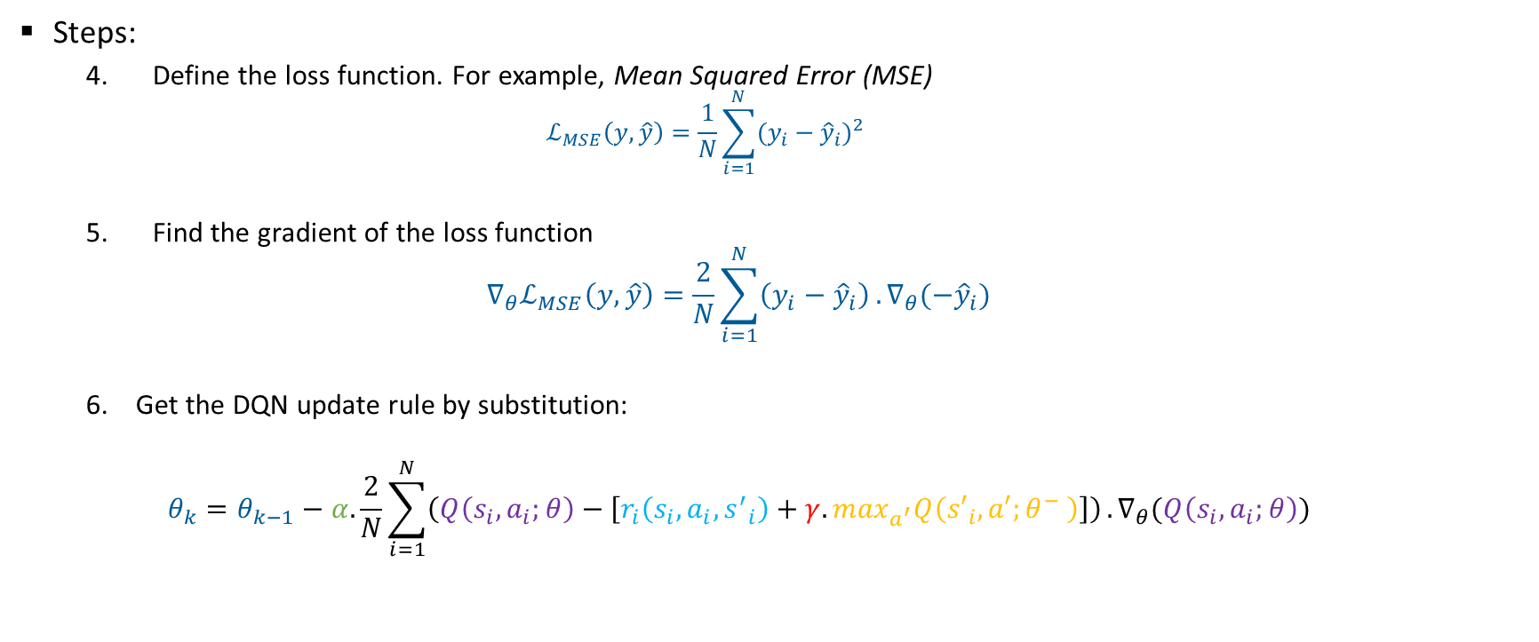
DQN: Update rule
Week 10: Deep Q-Learning (DQN)
Steps:
4. Define the loss function. For example, Mean Squared Error (MSE)
$$ℒ_{MSE}\left(y,\hat{y}\right)=\frac{1}{N}\sum_{i=1}^{N}{{(y_{i}−{\hat{y}}_{i})}^{2}}$$
5. Find the gradient of the loss function
$$∇_{θ}ℒ_{MSE}\left(y,\hat{y}\right)=\frac{2}{N}\sum_{i=1}^{N}{\left(y_{i}−{\hat{y}}_{i}\right)}.∇_{θ}(−{\hat{y}}_{i})$$
Get the DQN update rule by substitution:
$$θ_{k}=θ_{k−1}−α.\frac{2}{N}\sum_{i=1}^{N}{\left(Q\left(s_{i},a_{i};θ\right)−\left[r_{i}\left(s_{i},a_{i},{s^{′}}_{i}\right)+γ.\max_{a^{′}}Q\left({s′}_{i},a′;θ^{−} \right)\right]\right)}.∇_{θ}(Q\left(s_{i},a_{i};θ\right))$$

Slide 16
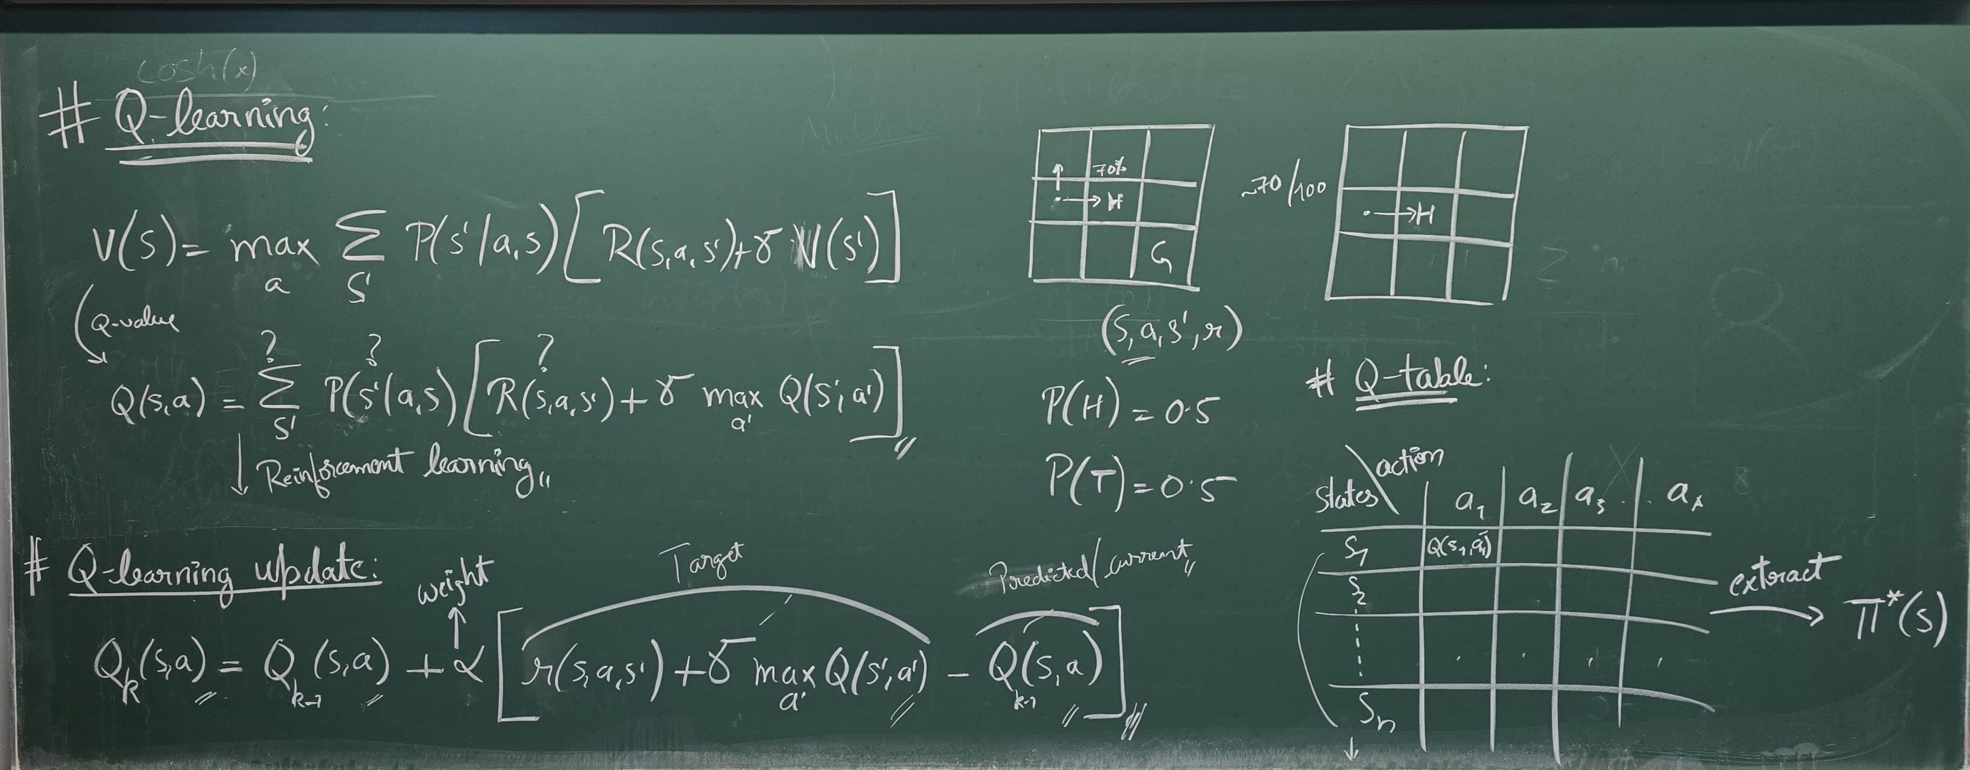
Lecture images
Week 10: Deep Q-Learning (DQN)

Slide 17
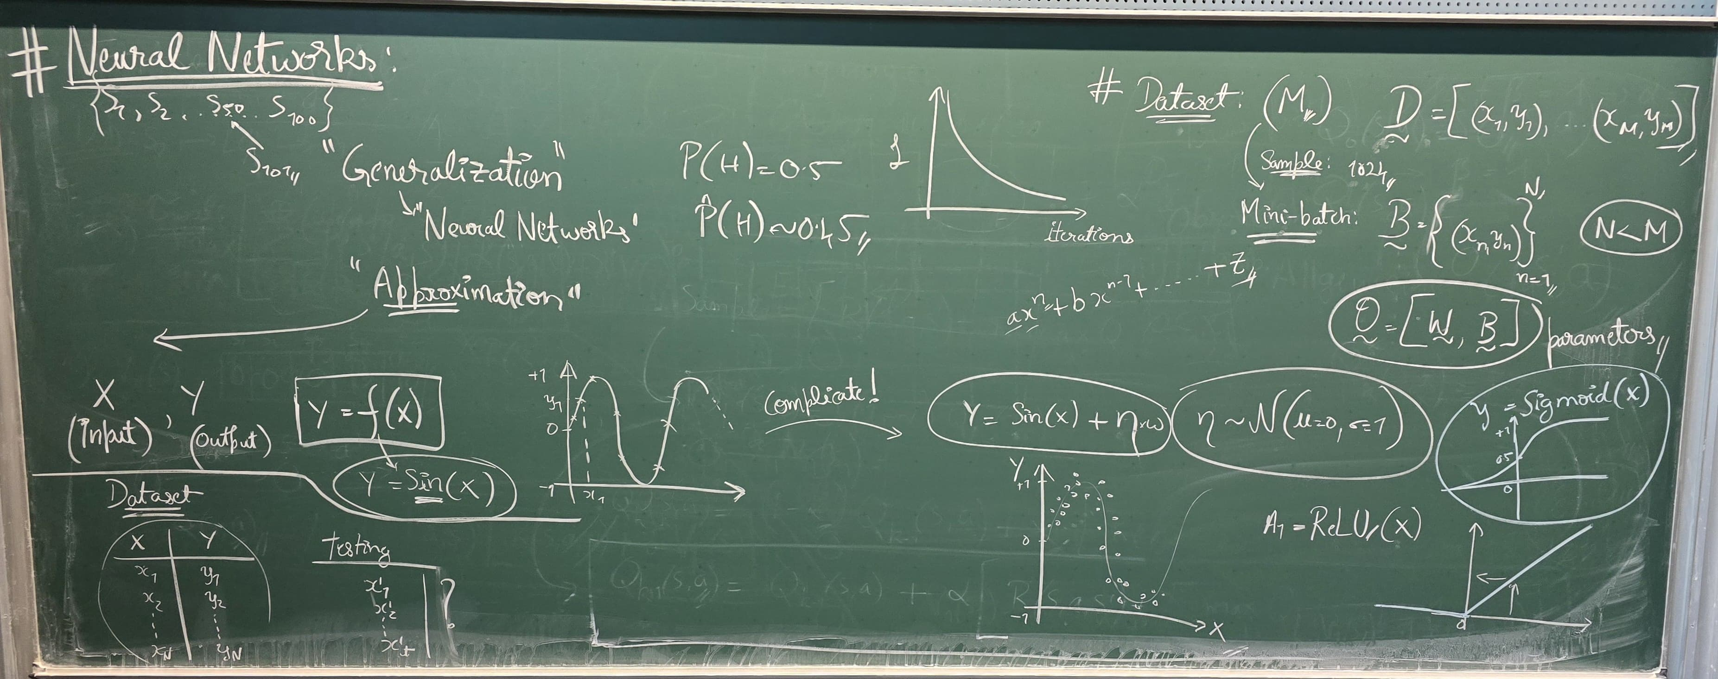
Lecture images
Week 10: Deep Q-Learning (DQN)

Slide 18
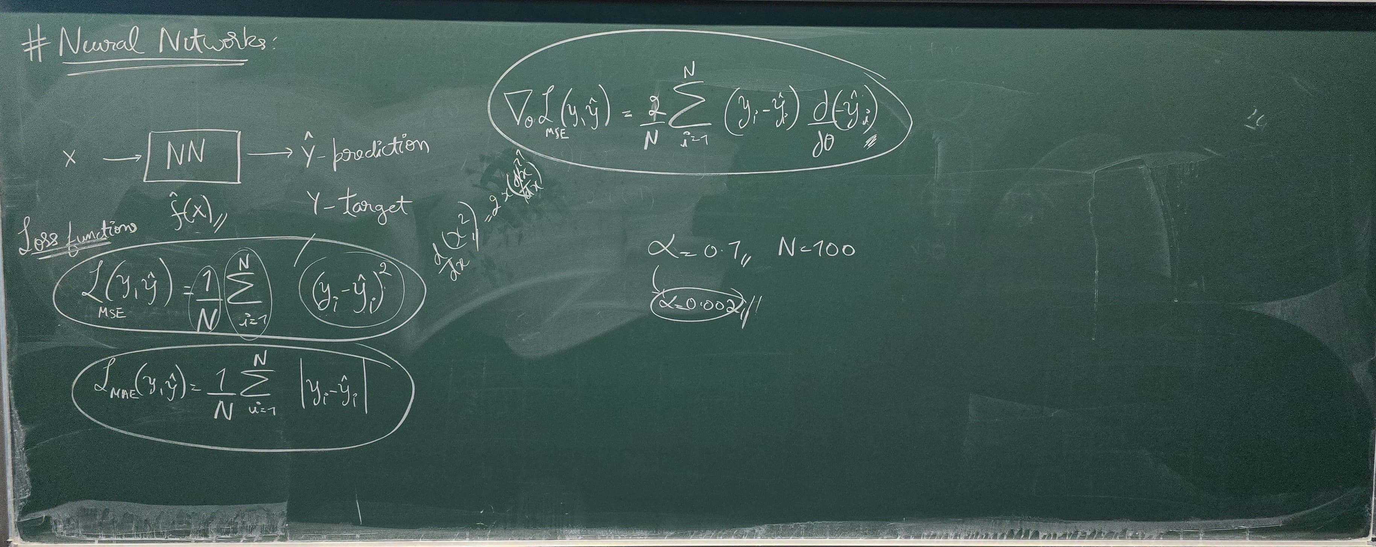
Lecture images
Week 10: Deep Q-Learning (DQN)

Slide 19
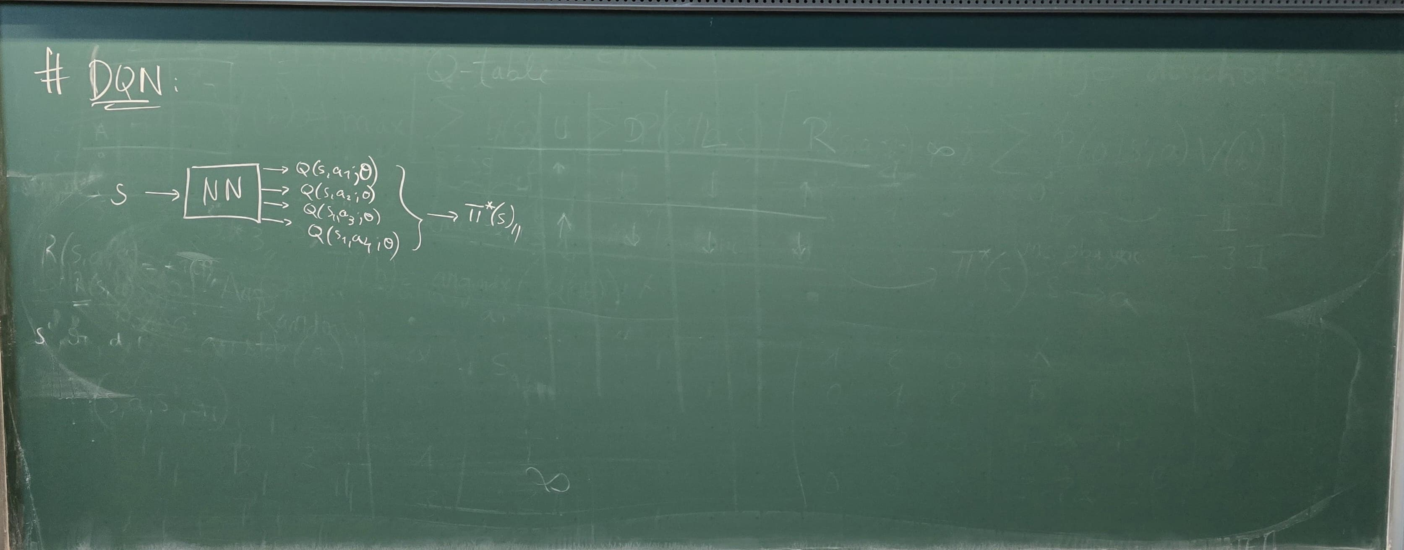
Lecture images
Week 10: Deep Q-Learning (DQN)

